Slide 1

Predicting Next-Day Movement of Indian Stock Market Sectors
Based on Geopolitical Risks
M.Sc. Dissertation Presentation
by
Kunal Goyal (2025MSBDA010)
Department of Data Science and Analytics
Central University of Rajasthan, Ajmer
Under the guidance of
External Guide
Not Applicable
Internal Guide
Dr. Bhavna Saini
Assistant Professor
Department of Data Science & Analytics
September 2026
Notes:
Good morning respected members of the committee and my supervisor, Dr. Bhavna Saini. Today I am presenting my M.Sc. dissertation titled “Predicting Next-Day Movement of Indian Stock Market Sectors Based on Geopolitical Risks.” The study investigates whether geopolitical information and graph-based modelling can help predict the next-day direction of Indian NIFTY sectoral indices. I compare classical machine-learning models with Graph Neural Networks under a chronological evaluation protocol.

Slide 2
Contents
2
01
Introduction
GNN Message Passing
01
06
06
02
Literature Survey
Results & Milestones
02
07
07
03
Objectives
Conclusion
03
08
08
04
Methodology
Future Work
04
09
09
05
Graph Construction
References
05
10
10
Problem → evidence → methodology → graph → results → conclusion
Notes:
This presentation follows the structure of the project template. I will first introduce the prediction problem, then briefly review the relevant literature and identify the research gap. Next, I will explain the objectives and methodology, discuss the experimental results and milestones, and finally present the conclusions, future work and references.

Slide 3
Introduction
3
The study asks whether the next-day direction of Indian sector indices can be predicted from market, macroeconomic and geopolitical information.
THE PROBLEM
WHAT MAY MATTER
WHY A GRAPH
• Target: UP or DOWN movement on the next trading day.
• Eight NIFTY sectoral indices are studied.
• Daily market movements contain substantial noise.
• Recent sector prices and technical behaviour.
• Gold, crude oil, USD/INR and India VIX.
• Geopolitical activity measured using GDELT.
• Sectors are not independent.
• Macro and country conditions can affect several sectors.
• A graph makes these assumed relationships explicit.
Scope: next-day direction prediction, not exact price forecasting.
• The study compares classical tabular models with graph neural networks and tests the contribution of GDELT through an ablation.
Notes:
The basic problem is to predict whether a sector will move up or down on the next trading day. I focus on eight NIFTY sectoral indices. This is difficult because daily market movements are noisy and short-term signals are weak. At the same time, sectors can respond differently to market conditions, macroeconomic variables and geopolitical events. Therefore, the study examines both conventional machine-learning models and a graph-based representation of these relationships. GDELT is used as a source of geopolitical event information.

Slide 4
Literature Survey
4
1. Financial Prediction
2. Graph Learning
3. Geopolitical Data
Fama (1970) provides the efficient-market foundation. Random Forest and XGBoost are used here as nonlinear tabular baselines for financial data.
GCN, GraphSAGE and GAT learn from connected entities. Their common idea is to update a node using information from its neighbourhood.
GDELT provides event, conflict and tone information at large scale. Its usefulness for short-horizon sector prediction is an empirical question.
RESEARCH GAP
The study combines three elements in one controlled experiment: (1) Indian sector indices, (2) a domain-informed heterogeneous graph, and (3) a direct with-GDELT versus without-GDELT comparison under chronological evaluation.
The gap is therefore experimental and methodological, rather than a claim that earlier models are inadequate.
Notes:
The literature relevant to this study can be understood through three areas. First, financial prediction research shows that daily directional prediction is difficult, and classical models such as Random Forest and XGBoost are useful nonlinear baselines. Second, Graph Neural Networks such as GCN, GraphSAGE and GAT provide methods for learning from relationships between connected entities, and they have been applied in financial and other relational settings. Third, GDELT provides machine-readable information about events, conflict and tone, making it useful as a geopolitical proxy. The gap addressed here is a controlled comparison for Indian sectoral indices that combines a domain-informed graph with a direct GDELT ablation and a chronological, leakage-conscious evaluation.

Slide 5
Objectives
5
Overall objective: evaluate whether geopolitical information and graph modelling improve next-day direction prediction of eight NIFTY sectors.
RESEARCH QUESTIONS
RQ1 — GDELT
RQ2 — MODELS
RQ3 — DIAGNOSTICS
Does adding GDELT-derived geopolitical information improve next-day sector-direction prediction?
Do the evaluated GNNs outperform the classical Random Forest and XGBoost baselines?
Do the graph models learn useful UP/DOWN discrimination, or do they collapse to a simple prediction pattern?
WHAT THE STUDY DELIVERS
• A reproducible multi-source dataset and chronological evaluation pipeline.
• A fixed heterogeneous graph with explicit node and edge assumptions.
• A comparison of classical baselines, four GNN architectures and a GDELT ablation.
Notes:
The overall objective is to evaluate whether geopolitical information and relational graph modelling improve next-day sector-direction prediction. I formulate three research questions. RQ1 asks whether GDELT features add predictive value. RQ2 asks whether the evaluated GNNs outperform the classical Random Forest and XGBoost baselines. RQ3 asks whether the graph models actually learn to distinguish UP from DOWN movements, rather than only producing a favourable-looking aggregate metric. These questions guide the data preparation, experiments and diagnostics.

Slide 6
Methodology
6
2,086 trading days | 2018–2026 | 8 sector targets | 114 raw columns
DATA
→
FEATURES
→
TARGET
→
CHRONOLOGICAL SPLIT
→
MODELS
→
EVALUATION
FEATURES
EXPERIMENTS
GRAPH MODELS
• Returns and log returns
• Moving-average ratios
• Volatility, momentum and RSI
• Macro variables
• GDELT event / conflict / tone features
• E1: technical + GDELT
• E2: technical only
• Same chronological evaluation
• RF and XGBoost baselines
• 21 nodes, 56 relationships
• Sector, macro, country, global
• GCN, GraphSAGE, GAT
• HGT-style
Only the eight sector nodes are prediction targets. Macro, country and global nodes participate in message passing and influence sector representations.
Notes:
The dataset covers 2,086 trading days from January 2018 to June 2026. It contains eight NIFTY sectors, four macroeconomic series—Gold, Oil, USD/INR and India VIX—and GDELT information for seven countries plus a global aggregate. The features include price-derived measures such as returns, moving-average ratios, volatility, momentum and RSI, together with GDELT event, conflict and tone indicators. The target is next-day UP or DOWN. The data is evaluated chronologically, with preprocessing fitted on training data. Two classical configurations are used: E1 with GDELT and E2 without GDELT. The graph pipeline uses a 21-node domain-informed graph with 56 relationships and evaluates GCN, GraphSAGE, GAT and an HGT-style model.

Slide 7
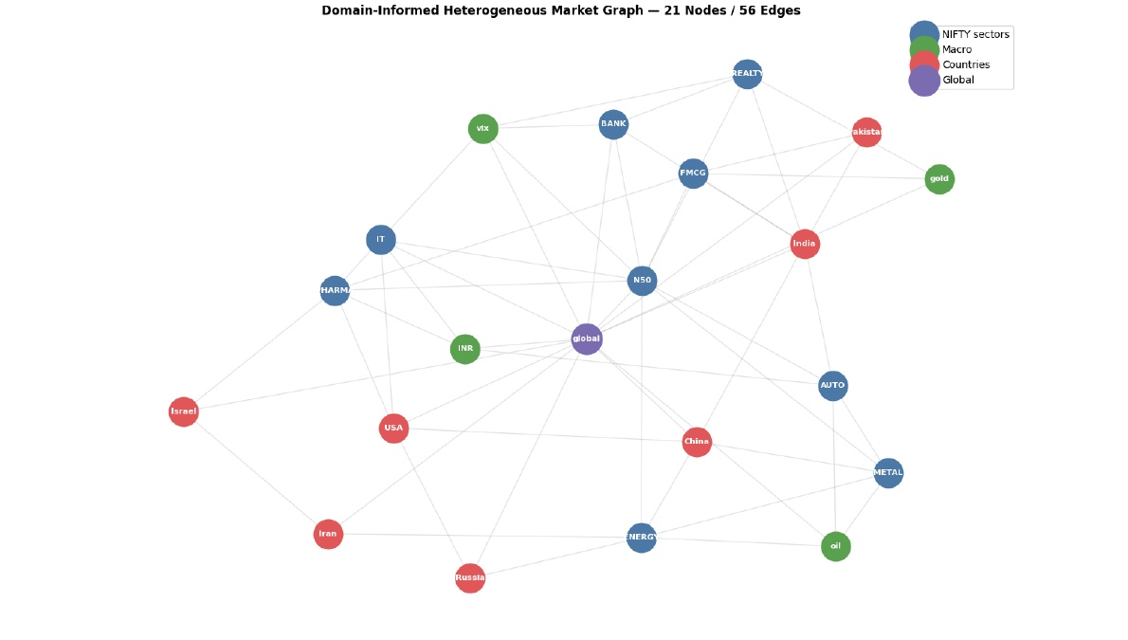
Graph Construction
7
A fixed, domain-informed heterogeneous graph is built once and reused across trading days; node features change with time, but the topology does not.
NODE TYPES
• 9 index nodes: NIFTY sectors + NIFTY 50
• 4 macro nodes: gold, oil, USD/INR, VIX
• 7 country nodes
• 1 global node
EDGE GROUPS
• Sector–sector: 5
• Macro–sector: 12
• Country–sector: 12
• Country–country: 5
• Global–macro: 4
• Global–country: 18
56 unique undirected relationships → symmetric adjacency matrix → reused for every day.
• Edges encode modelling assumptions about related entities; they should not be interpreted as causal effects.
Notes:
This slide explains how the graph used in the dissertation was constructed. There are 21 nodes: NIFTY 50 plus eight sector indices, four macroeconomic nodes, seven country nodes and one global GDELT node.
The 56 unique undirected relationships are grouped into six relation types: benchmark-to-sector, sector-to-sector, macro-to-sector, country-to-sector, country-to-country and global-to-other. The edges were chosen from economic and geopolitical reasoning. They are modelling assumptions that provide relational structure; they are not claims that one entity causes another.
The topology is fixed. Duplicate pairs are removed, the relationships are expanded into a symmetric adjacency matrix, and the same topology is reused for every trading day. Only the node features change from day to day.

Slide 8
GNN Message Passing
8
The graph is the same for all four models. What changes is how a node uses information from its neighbours.
GCN
GraphSAGE
GAT
HGT-style
Fixed normalized aggregation
Neighbour aggregation + self
Learned edge attention
Type-aware attention
Neighbour messages are weighted by graph degree.
Aggregated neighbours are combined with the node's own representation.
Each existing edge receives a learned attention weight.
Attention also uses node type and relation type, with residual + layer norm.
H⁽ˡ⁺¹⁾ = σ(D̃⁻¹ᐟ² Ã D̃⁻¹ᐟ² H⁽ˡ⁾W⁽ˡ⁾)
h' = σ(W · [hᵢ || AGG(N(i))])
αᵢⱼ = softmax(score(hᵢ,hⱼ))
attention + type/relation bias
COMMON SETUP
• Two message-passing layers • hidden size 48 • dropout 0.20 • eight sector nodes used for prediction.
• GAT and HGT-style use four attention heads; HGT-style additionally conditions attention on node and relation types.
Notes:
This slide explains the main difference between the four graph models. The graph itself stays the same; the message-passing rule changes.
GCN uses normalized adjacency, so neighbour contributions are determined by the fixed topology and degree. GraphSAGE aggregates neighbour representations and concatenates that aggregate with the node's own representation before the transformation. GAT learns an attention coefficient for each existing edge, allowing different neighbours to receive different weights.
The HGT-style model is type-aware. It adds node-type information and uses relation-type information in four-head attention, together with residual connections and layer normalization. This is important because the graph contains different kinds of relationships, such as country-to-sector and macro-to-sector.
All four models in this dissertation use two message-passing layers, hidden size 48 and dropout 0.20. Only the eight sector nodes are prediction targets; the other nodes influence predictions through message passing.

Slide 9
Results & Milestones
9
CLASSICAL ML — MEAN TEST RESULTS
INTERPRETATION
Model | Features | Accuracy | Macro F1 | ROC-AUC
Random Forest E1 | Tech + GDELT | 50.77% | 44.41% | 0.5315
Random Forest E2 | Technical | 50.62% | 42.93% | 0.5310
XGBoost E1 | Tech + GDELT | 50.03% | 39.56% | 0.5060
XGBoost E2 | Technical | 51.67% | 44.23% | 0.5134
• Accuracy remains close to the 50% reference.
• GDELT does not show a consistent improvement.
• XGBoost E2 has the highest accuracy in this table, but the difference is small.
GNN TEST DIAGNOSTIC
WHAT THIS MEANS
Model | ROC-AUC | Observed behaviour
HGT-style | 0.5018 | UP for every test observation
GAT | 0.4936 | UP for every test observation
GCN | 0.4858 | UP for every test observation
GraphSAGE | 0.4855 | UP for every test observation
The GNNs did not establish useful UP/DOWN discrimination. The positive-class F1 of 0.6814 comes from the constant-UP behaviour and is therefore not evidence of strong classification.
MILESTONES ACHIEVED
• Multi-source dataset integrated • heterogeneous graph constructed • classical baselines completed • GDELT ablation completed • GNN behaviour diagnosed
Notes:
This slide presents the results as evidence rather than as a leaderboard.
The first table gives the mean test performance of the classical models across the eight sectors. E1 contains technical and GDELT features, while E2 contains the technical features only. The values remain close to the 50 percent reference, and the GDELT comparison does not show a consistent improvement.
The second table is deliberately labelled as a diagnostic. HGT-style has the highest ROC-AUC among the four GNNs at 0.5018, but all four graph models predicted UP for every test observation. This is why the positive-class F1 of 0.6814 must not be treated as evidence of good UP/DOWN discrimination.
The milestones at the bottom summarise what was actually completed: the multi-source data pipeline, the heterogeneous graph, the classical baselines, the GDELT ablation and the GNN diagnostic analysis.
The main point to communicate is that the experiment was able to test the proposed ideas and also reveal where the current setup does not provide reliable predictive discrimination.

Slide 10
Conclusion
10
RQ1 — GDELT
RQ2 — GNN VS ML
RQ3 — DIAGNOSTICS
The tested GDELT features did not provide a reliable improvement over the corresponding technical-only configurations.
Under the tested dataset, graph construction and training configuration, the GNNs did not demonstrate an advantage over the classical baselines.
All four GNNs predicted UP for the test observations, so useful UP/DOWN discrimination was not established.
OVERALL CONCLUSION
For this dataset and experimental setup, increasing model complexity did not automatically improve next-day sector prediction. The ablation and diagnostic analysis were essential for interpreting the results.
These conclusions are specific to the tested data, feature construction, graph topology and abbreviated GNN training configuration.
Notes:
The conclusions answer the three research questions directly. First, GDELT did not provide a reliable improvement under the tested classical configurations. Second, the tested GNNs did not demonstrate an advantage over the classical baselines under this particular dataset, graph design and training setup. Third, the GNNs showed constant-UP behaviour, so they did not establish useful UP-versus-DOWN discrimination. The important point is that these conclusions apply to the configuration tested; they do not establish that GNNs or geopolitical information can never be useful.

Slide 11
Future Work
11
01
Improve GNN training
04
Dynamic graph models
Use longer training schedules, repeated seeds and stronger model-selection procedures.
Allow relationships to change over time and investigate temporal GNNs.
02
Stronger temporal evaluation
05
Practical evaluation
Use walk-forward / rolling-origin validation and report stability across periods.
If predictive signal emerges, evaluate it through a trading backtest with transaction costs.
03
Improve data and timing
Expand macro coverage and verify publication timestamps for GDELT and macro data.
These are proposed extensions; they were not part of the reported experimental results.
Notes:
The future work comes directly from the limitations identified in the dissertation. The first priority is to rerun the graph experiments with longer training and repeated settings. Stronger temporal evaluation such as walk-forward validation and multiple random seeds can test stability. The data pipeline can be improved by adding complete macroeconomic coverage and verifying information-availability timestamps. The graph can be made dynamic so that relationships change over time, and temporal GNNs can be explored. Finally, explainability can be extended, and if meaningful predictive performance is obtained, practical usefulness can be tested with a backtest including transaction costs. These are proposed extensions and were not performed in the current study.

Slide 12
References
12
JOURNAL / CONFERENCE PAPERS
OTHER SOURCES
• Fama, E. F. (1970), “Efficient Capital Markets: A Review of Theory and Empirical Work.”
• Caldara, D. & Iacoviello, M. (2022), “Measuring Geopolitical Risk.”
• Kipf, T. N. & Welling, M. (2017), “Semi-Supervised Classification with Graph Convolutional Networks.”
• Hamilton, W. L., Ying, Z. & Leskovec, J. (2017), “Inductive Representation Learning on Large Graphs.”
• Veličković, P. et al. (2018), “Graph Attention Networks.”
• Leetaru, K. & Schrodt, P. A. (2013), “GDELT: Global Data on Events, Location, and Tone.”
• Hastie, T., Tibshirani, R. & Friedman, J. (2009), The Elements of Statistical Learning, 2nd ed.
• GDELT Project Event Database — geopolitical event and tone data.
• National Stock Exchange of India (NSE) — NIFTY sectoral index data.
The complete reference list and dataset details are provided in the dissertation.
Notes:
These are the main references supporting the dissertation. They include Fama's work on market efficiency, research on geopolitical risk, foundational GNN papers for GCN, GraphSAGE and GAT, and the GDELT source. I have also included the main data sources used in the study. The complete reference list is available in the dissertation. Thank you for your attention. I am happy to answer questions.

